Slide 1
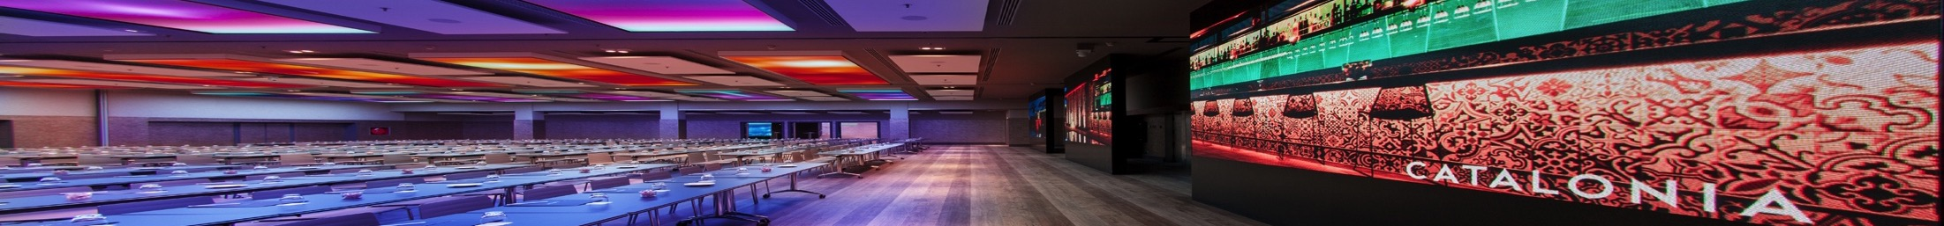

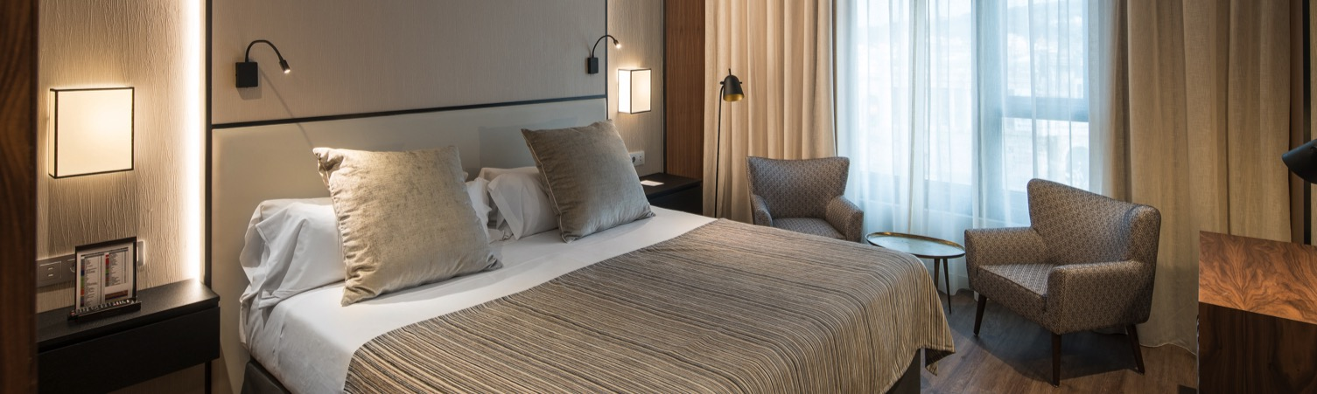

Slide 2
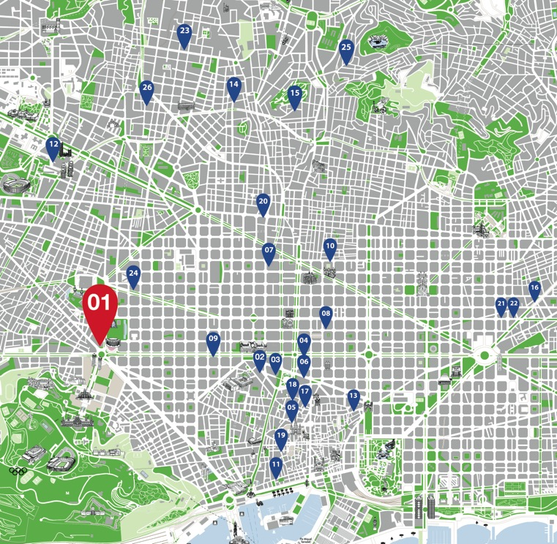
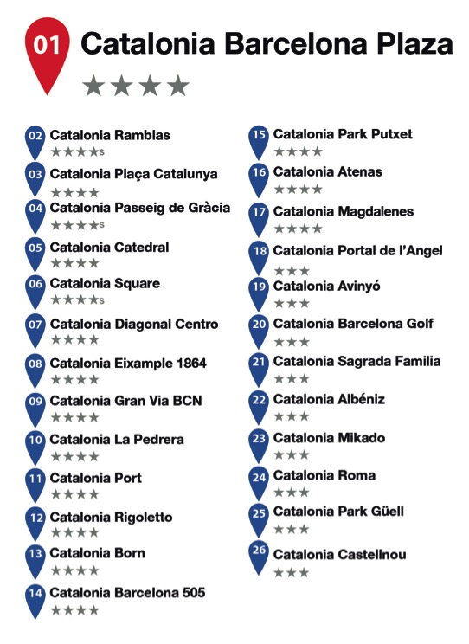

Our hotels
Barcelona
cataloniahotels.com

Slide 3
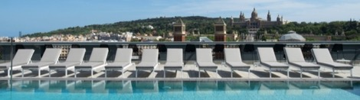
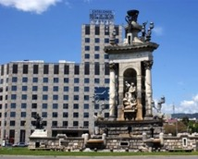
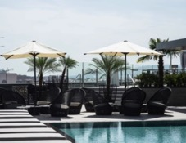
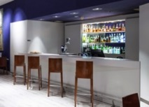
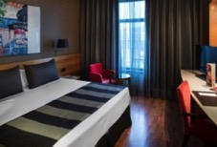
Catalonia Barcelona plaza
This stunning hotel is situated in Plaza España, next to the Fira de Barcelona Montjuïc. With excellent access to all public transport, it has its own parking and is ideal for staying in business or for a few days off. The panoramic terrace and most rooms have unbeatable views.
Plaça Espanya, 6-8 | 08014 Barcelona
347 rooms
170 twins
10 min from the airport
Swimming pool
Fitness center with sauna
2 restaurants
24h Room Service
Parking in the same building
Meeting room
Wi-Fi internet
cataloniahotels.com

Slide 4
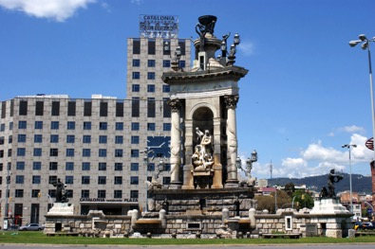
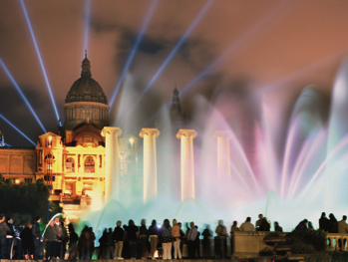
Catalonia Barcelona plaza
Location
Plaça Espanya, 6-8
08014 Barcelona
Next to the Fira of Montjuïc.
In front of the Palacio Nacional and the Font Màgica.
Surrounded by restaurants, shops and a great shopping mall.
Easy access to any part of the city.

Slide 5
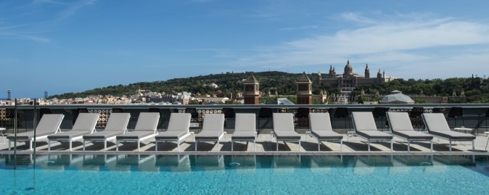
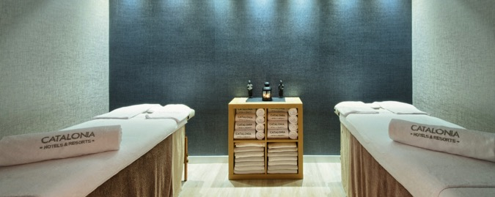
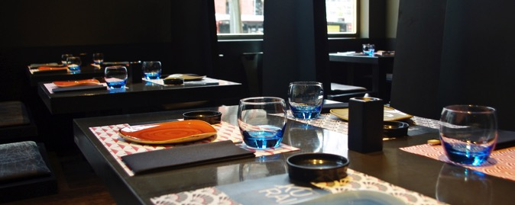
Catalonia Barcelona plaza
Services
Free Wifi
Panoramic terrace with swimming pool
Restaurant Filigrana: Mediterranean cuisine restaurant
Restaurant Kurai: Japanese restaurant
The Clock Terrace: restaurant & cocktail bar
Gourmet Corner: Snack bar
Wellness center
Fitness room
Room service
Parking

Slide 6
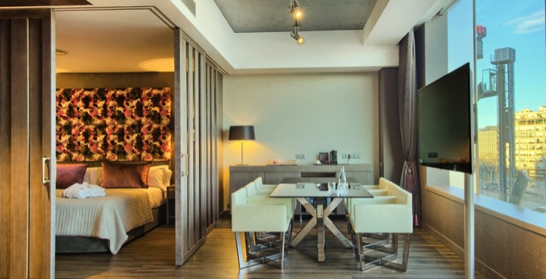
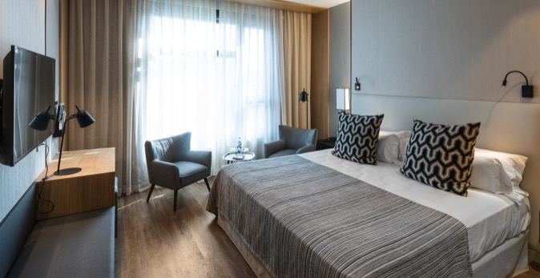
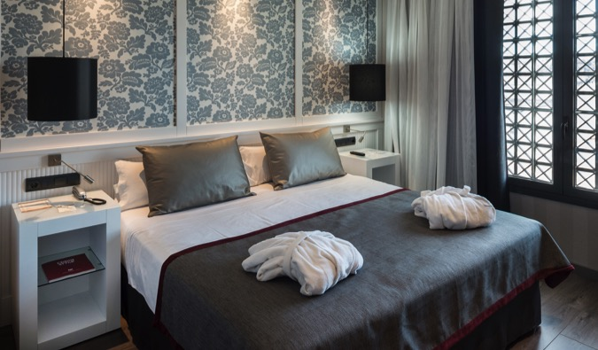
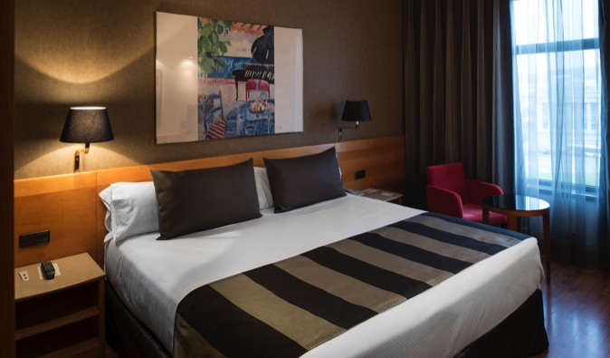
Catalonia Barcelona plaza
Rooms

Slide 7
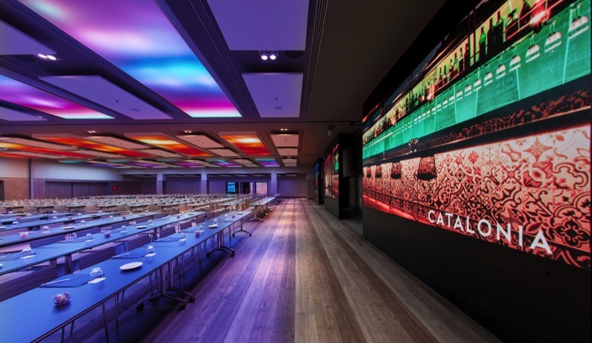
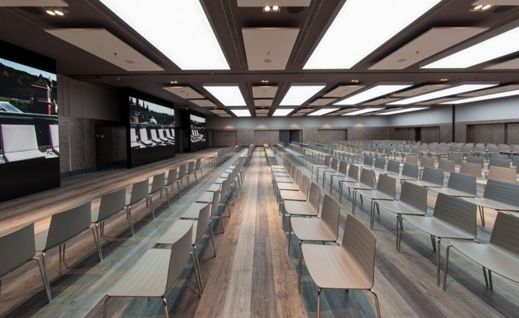
Catalonia Barcelona plaza
Meeting rooms
Meeting facilites with more than 1500sqm, fully renewed, equiped with the latest technology.
Maximum capacity for 700 people.
Personalized atention and service.

Slide 8
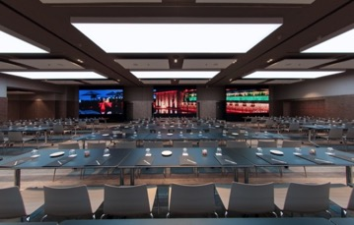
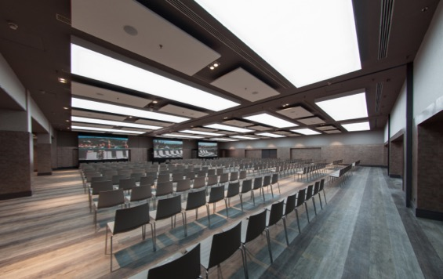
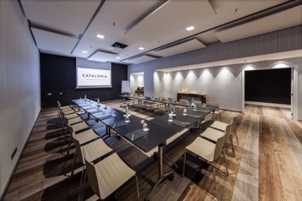
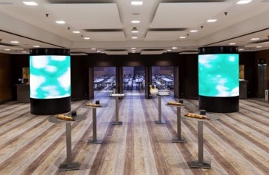
Catalonia Barcelona plaza
Meeting rooms
cataloniahotels.com

Slide 9
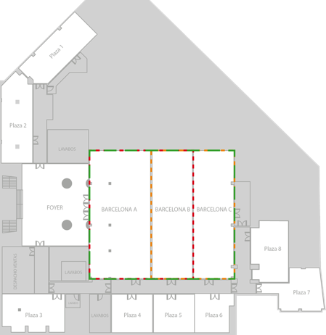
Catalonia Barcelona plaza
Meeting rooms
cataloniahotels.com

Slide 10
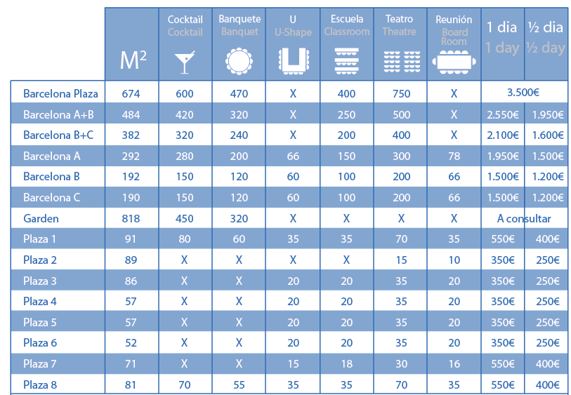
Catalonia Barcelona plaza
Meeting rooms
cataloniahotels.com

Slide 11
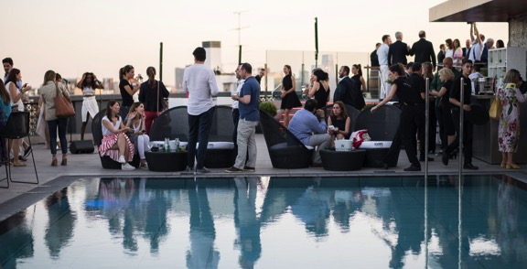
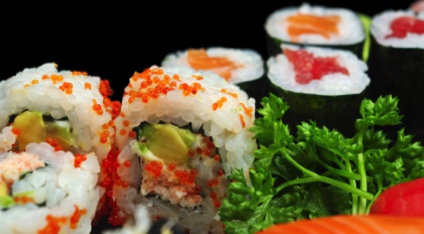
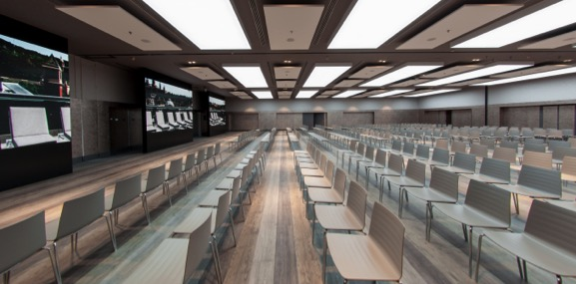
Catalonia Barcelona plaza
Why to choose our hotel
Great location
Well connected by public transportation
Panoramic terrace for events
Cutting-edge technology
Great variety of national and international cuisine
Client oriented service

Slide 12

Catalonia Barcelona plaza

